Slide 1



ONLINE BOOKS STORE

Slide 2
Team Members:
P.Mahendra Babu 2200030434
K.Devi Karthikeya 2200030251
K.Vamsi 2200030997

Slide 3
Agenda
Introduction
Survey
Modules
Software and Hardware req
Proposed Model

Slide 4

Introduction
Online book stores are businesses that sell books through the internet. They offer a wide variety of books, including fiction, non-fiction, children's books, textbooks, and more. Online book stores typically have lower prices than traditional brick-and-mortar bookstores, and they offer a wider selection of books. They also make it easy to find books by genre, author, or title.
4

Slide 5

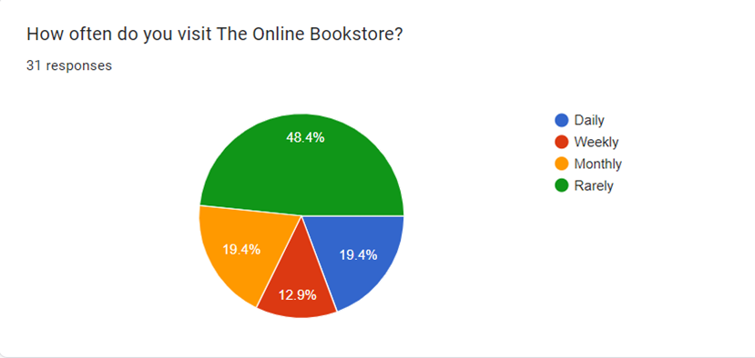

SURVEY

Slide 6
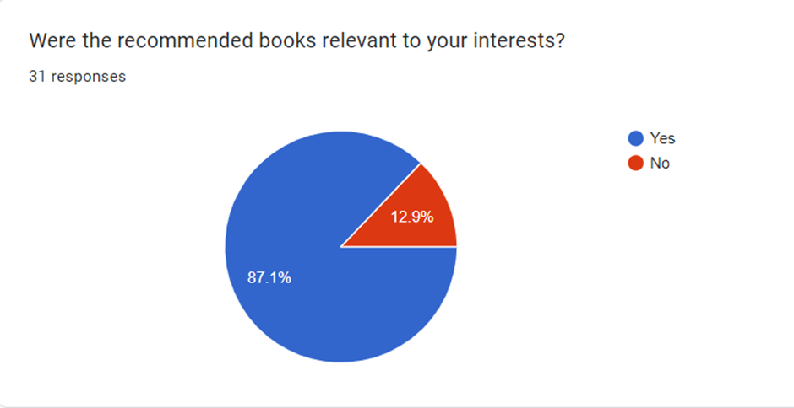
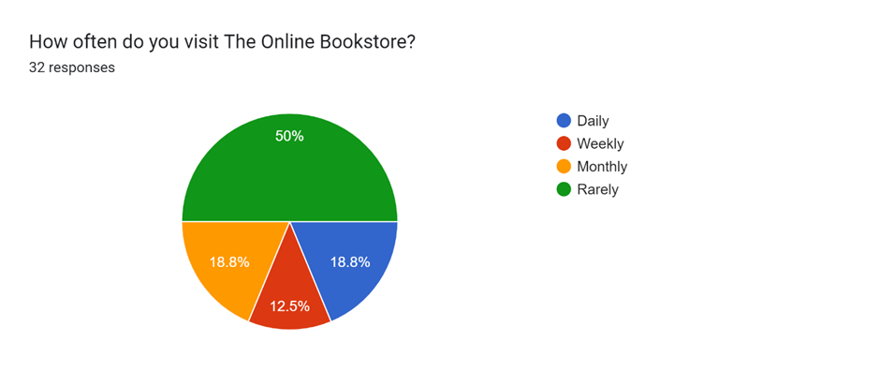
SURVEY-A

Slide 7
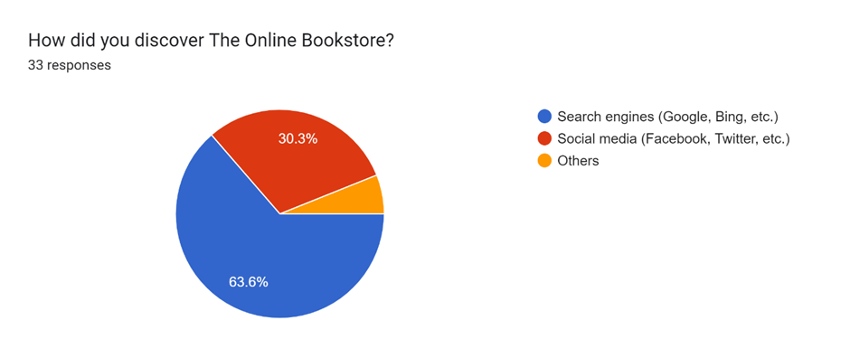
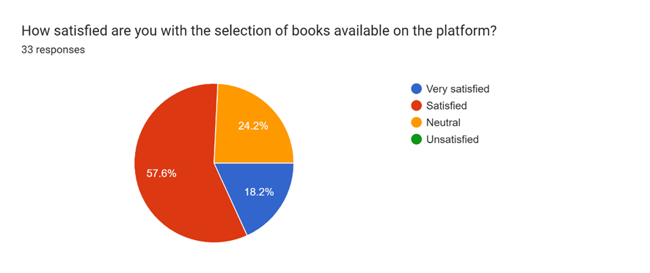
SURVEY-B

Slide 8





SOFTWARES REQUIRED
pycharm ide
DJANGO
HTML
CSS
WEB BROWSER
Powerful integrated development environment (IDE) for Python
Disseminate standardized metrics
Websites are built using HTML for structure
CSS for styling of webpages
You'll need a web browser to test your website during development.
8

Slide 9



HARDWARE REQUIRED :
COMPUTER & DISPLAY
KEYBOARD & MOUSE
INTERNET
A laptop or desktop with a multi-core processor, at least 8 GB of RAM
A comfortable display size and resolution are important for coding and design work.
A modern computer with sufficient processing power and memory is essential for efficient software development.
A comfortable keyboard and mouse (or trackpad) are necessary for coding and navigating your development environment.
A stable internet connection is essential for accessing documentation, libraries, version control, and online resources while developing your Django website.

Slide 10
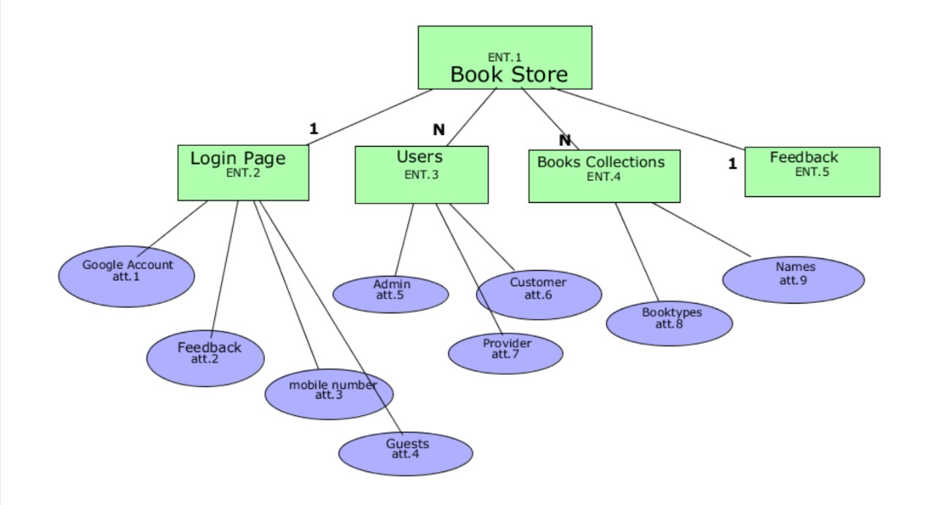
MODULES:

Slide 11

Summary
Online book stores are websites where you can buy books. They offer a wide variety of books, including new releases, bestsellers, classics, and textbooks. You can also find books in a variety of formats, including paperback, hardback, e-books, and audiobooks.
Online book stores offer a number of advantages over traditional brick-and-mortar bookstores. They typically have a wider selection of books, and they are often cheaper. You can also find books that are out of print or hard to find in traditional bookstores.
Some of the most popular online book stores include Amazon, Barnes & Noble, and Bookshop.org. These stores offer a variety of features, such as free shipping, gift cards, and loyalty programs.
11

Slide 12




Thank you

